Slide 1
Lectures 12 & 13 & 14 Curve Fitting: Regression
CSE 2207
Numerical Methods

Slide 2


Curve Fitting: Regression
The method of establishing relationship between dependent variable and independent variable(s) for experiment data in a mathematical equation form is known as regression analysis or curve fitting
e.g. relationship between maintenance cost of a vehicle as a function of age (mileage)
We prepare a scatter diagram and draw a line which represents the trend of the data
Our objective is to assume a line so that the avg. error between plotted data points and the assumed line is minimum
Experimental data points
Error, $q_{i}$
f(x)
Assumed line
$$y=a+bx$$
x

Slide 3
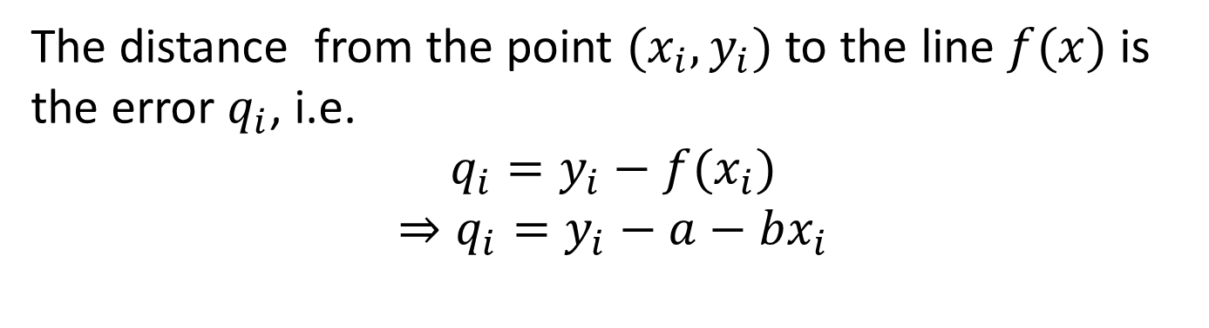




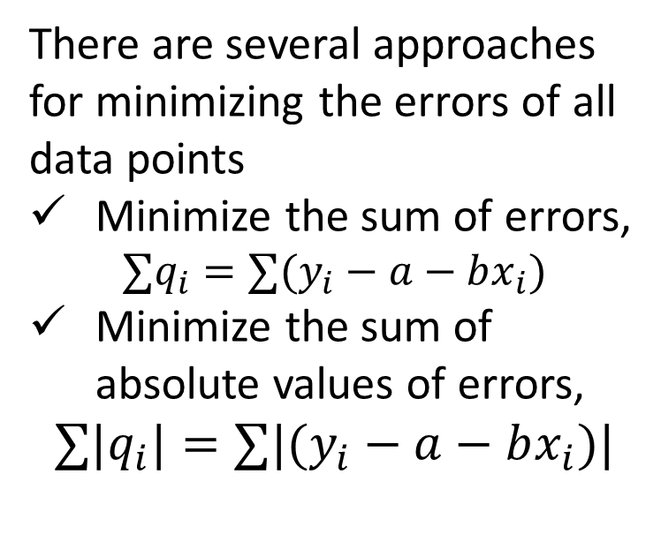
Curve Fitting: Regression
Assume the linear equation $y=f\left(x\right)=a+bx$
The distance from the point $(x_{i}, y_{i})$ to the line $f(x)$ is the error $q_{i}$, i.e.
$$q_{i}=y_{i}−f(x_{i})$$
$$⇒q_{i}=y_{i}−a−bx_{i}$$
There are several approaches for minimizing the errors of all data points
Minimize the sum of errors,
$$∑q_{i}=∑(y_{i}−a−bx_{i})$$
Minimize the sum of absolute values of errors,
$$∑{|q}_{i}|=∑|(y_{i}−a−bx_{i})|$$
$${(x}_{i},f(x_{i}))$$
Experimental data points
Assumed line
Error, $q_{i}$
$$y=a+bx$$
$${(x}_{i}, y_{i})$$
f(x)
x

Slide 4
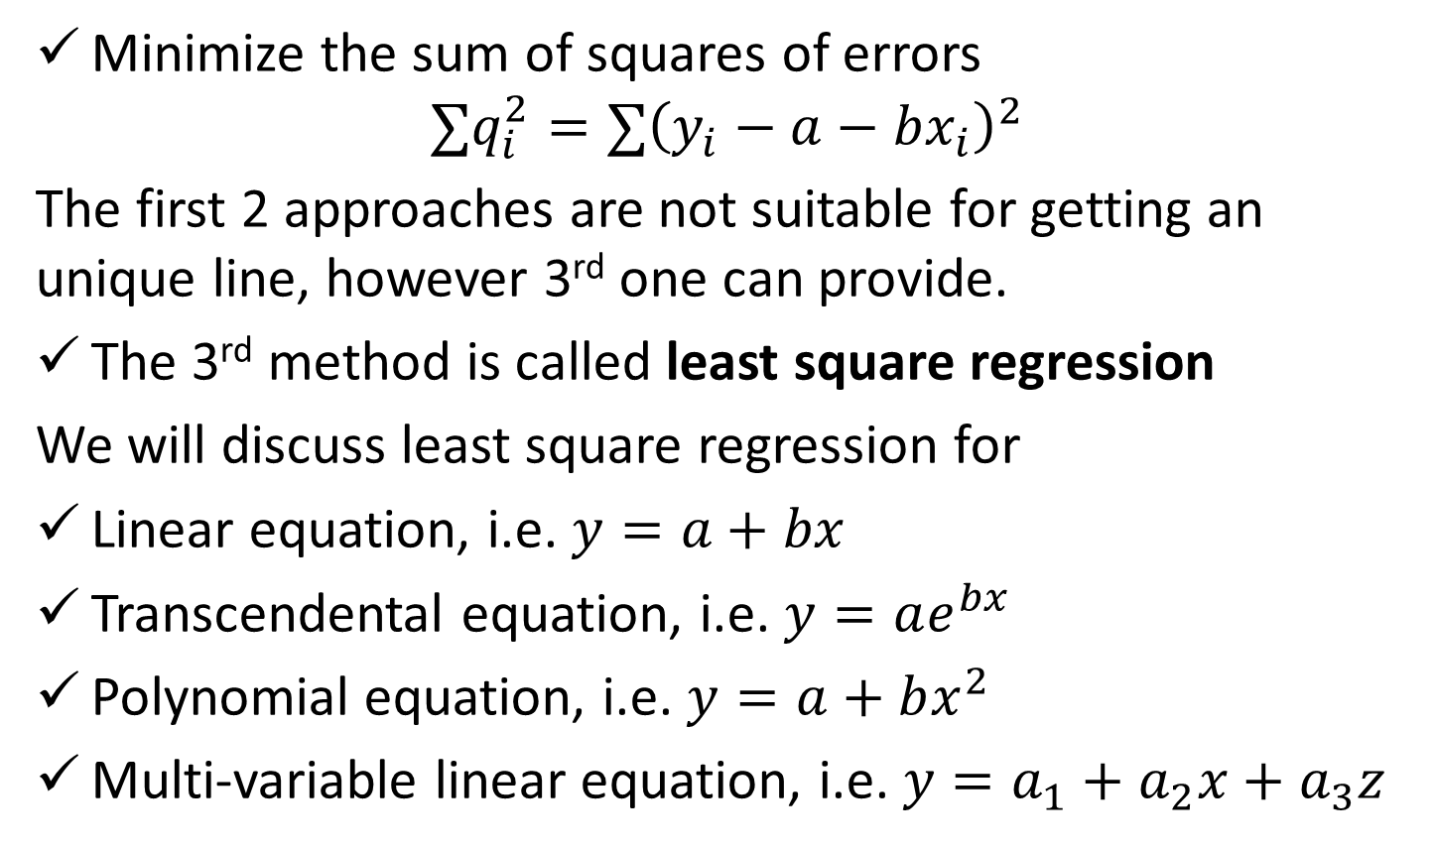
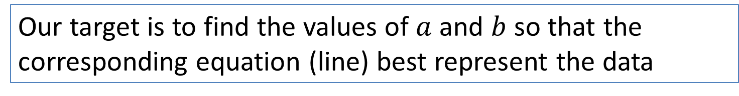
Curve Fitting: Regression
Minimize the sum of squares of errors
$$∑q_{i}^{2}=∑{\left(y_{i}−a−bx_{i}\right)}^{2}$$
The first 2 approaches are not suitable for getting an unique line, however 3rd one can provide.
The 3rd method is called least square regression
We will discuss least square regression for
Linear equation, i.e. $y=a+bx$
Transcendental equation, i.e. $y=ae^{bx}$
Polynomial equation, i.e. $y=a+bx^{2}$
Multi-variable linear equation, i.e. $y=a_{1}+a_{2}x+a_{3}z$
Our target is to find the values of $a$ and $b$ so that the corresponding equation (line) best represent the data

Slide 5
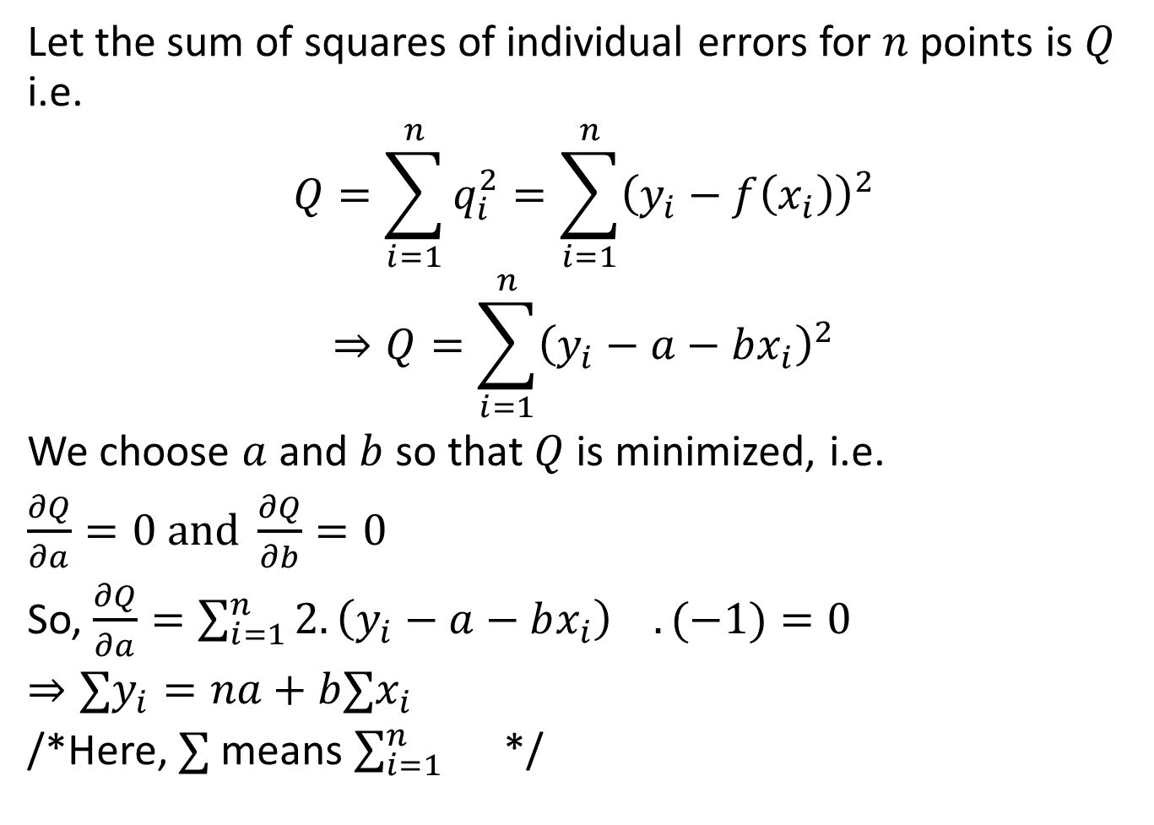
Least Square Regression: Linear Equation
Let the sum of squares of individual errors for $n$ points is $Q$ i.e.
$$Q=\sum_{i=1}^{n}{q_{i}^{2}=\sum_{i=1}^{n}{{\left(y_{i}−f\left(x_{i}\right)\right)}^{2}}}$$
$$⇒Q=\sum_{i=1}^{n}{{\left(y_{i}−a−bx_{i}\right)}^{2}}$$
We choose $a$ and $b$ so that $Q$ is minimized, i.e.
$\frac{∂Q}{∂a}=0 and \frac{∂Q}{∂b}=0$
So, $\frac{∂Q}{∂a}=\sum_{i=1}^{n}{2.{\left(y_{i}−a−bx_{i}\right)}^{}}.(−1)=0$
$⇒∑y_{i}=na+b∑x_{i}$
/*Here, $∑$means $\sum_{i=1}^{n}{}$ */

Slide 6
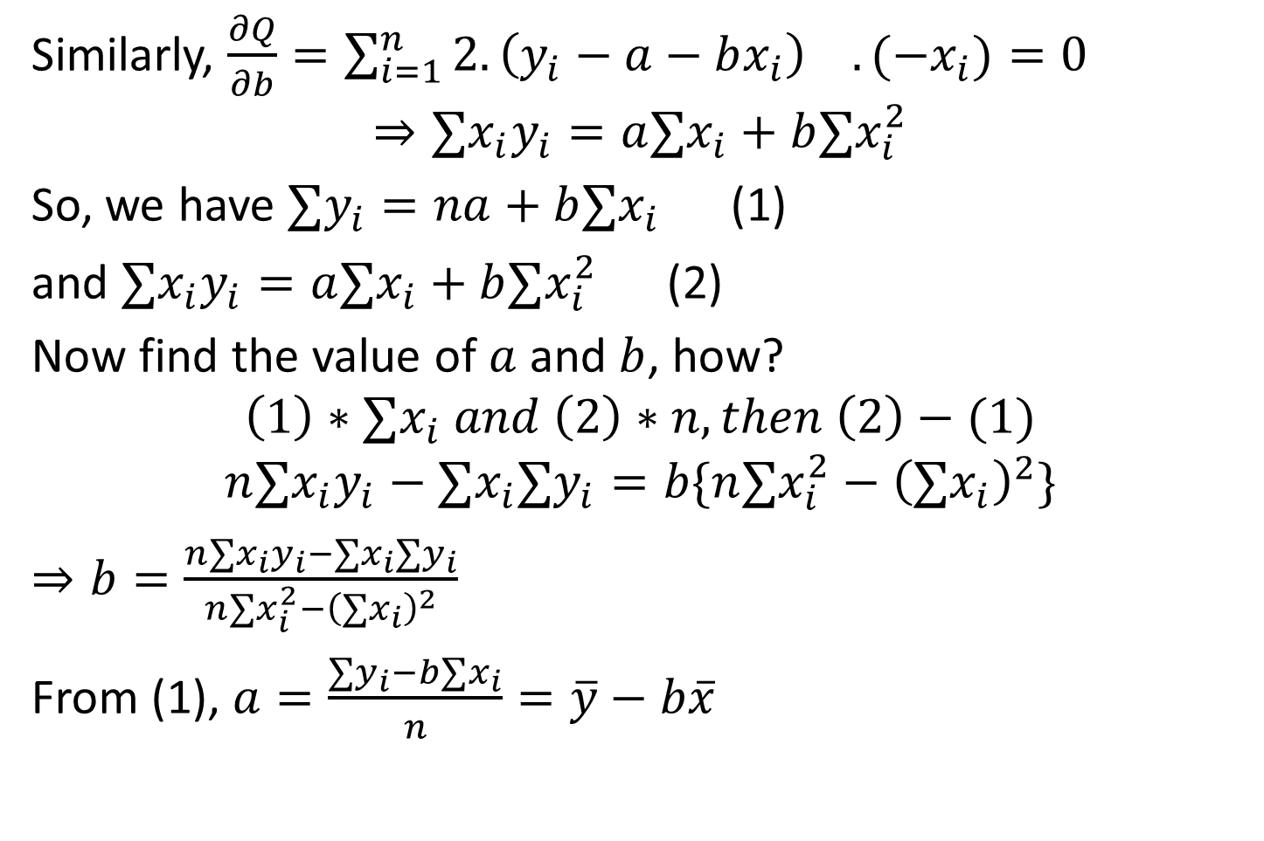
Least Square Regression: Linear Equation
Similarly, $\frac{∂Q}{∂b}=\sum_{i=1}^{n}{2.{\left(y_{i}−a−bx_{i}\right)}^{}}.(−x_{i})=0$
$$⇒∑x_{i}y_{i}=a∑x_{i}+b∑x_{i}^{2}$$
So, we have $∑y_{i}=na+b∑x_{i}$ (1)
and $∑x_{i}y_{i}=a∑x_{i}+b∑x_{i}^{2}$ (2)
Now find the value of $a$ and $b$, how?
$$\left(1\right)∗∑x_{i} and \left(2\right)∗n, then \left(2\right)−(1)$$
$$n∑x_{i}y_{i}−∑x_{i}∑y_{i}=b\{n∑x_{i}^{2}−{\left(∑x_{i}\right)}^{2}\}$$
$⇒b=\frac{n∑x_{i}y_{i}−∑x_{i}∑y_{i}}{n∑x_{i}^{2}−{\left(∑x_{i}\right)}^{2}}$
From (1), $a=\frac{∑y_{i}−b∑x_{i}}{n}=\overline{y}−b\overline{x}$

Slide 7

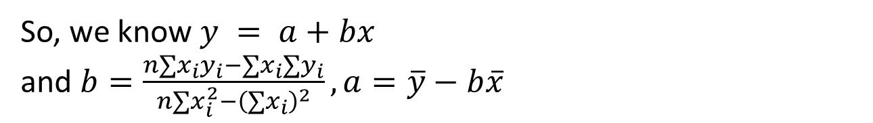



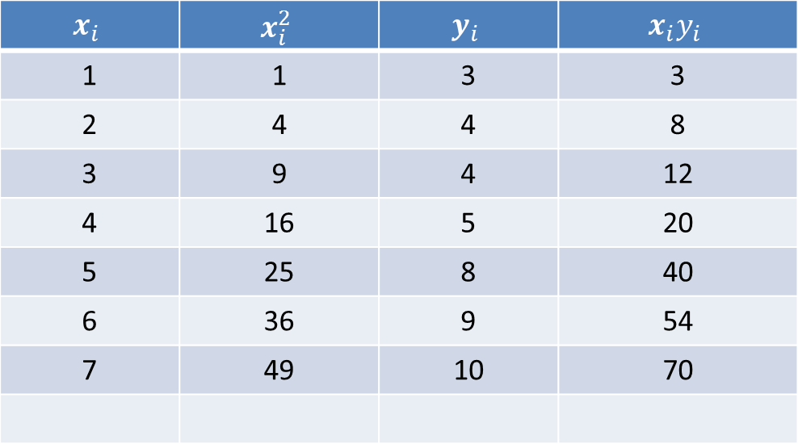
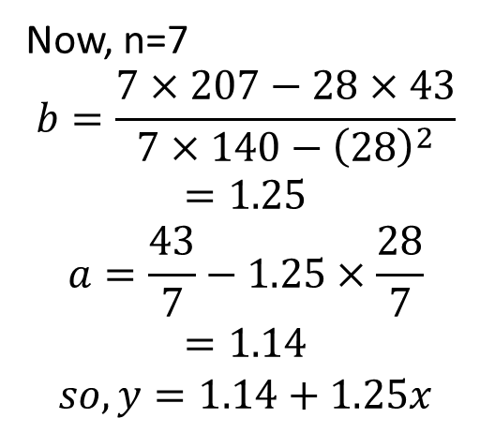
Least Square Regression: Linear Equation
Fit a straight line for the following set of data
x | 1 | 2 | 3 | 4 | 5 | 6 | 7
y | 3 | 4 | 4 | 5 | 8 | 9 | 10
So, we know $y = a+bx$
and $b=\frac{n∑x_{i}y_{i}−∑x_{i}∑y_{i}}{n∑x_{i}^{2}−{\left(∑x_{i}\right)}^{2}},a=\overline{y}−b\overline{x}$
$$x_{i}$$ | $$x_{i}^{2}$$ | $$y_{i}$$ | $$x_{i}y_{i}$$
1 | 1 | 3 | 3
2 | 4 | 4 | 8
3 | 9 | 4 | 12
4 | 16 | 5 | 20
5 | 25 | 8 | 40
6 | 36 | 9 | 54
7 | 49 | 10 | 70
Now, n=7
$$b=\frac{7×207−28×43}{7×140−{\left(28\right)}^{2}}$$
$$=1.25$$
$$a=\frac{43}{7}−1.25×\frac{28}{7}$$
$$=1.14$$
$$so, y=1.14+1.25x$$
$$∑x_{i}=28$$
$$∑x_{i}^{2}=140$$
$$∑y_{i}=43$$
$$∑x_{i}y_{i}=207$$

Slide 8
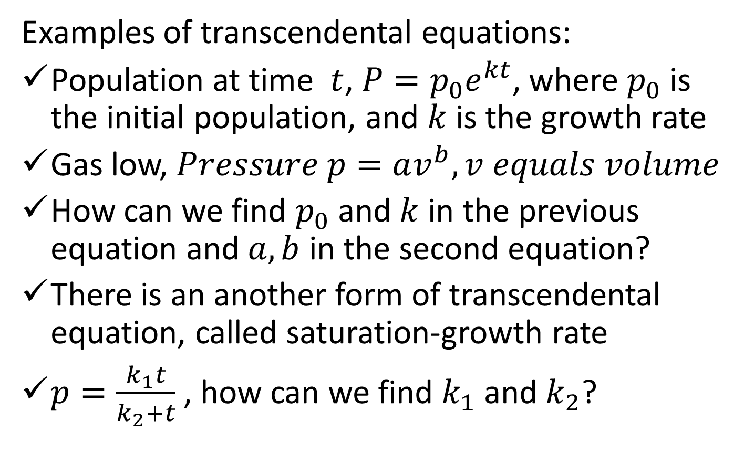
Least Square Regression: Transcendental Equation
Examples of transcendental equations:
Population at time $t$, $P=p_{0}e^{kt}$, where $p_{0}$ is the initial population, and $k$ is the growth rate
Gas low, $Pressure p=av^{b}, v equals volume$
How can we find $p_{0}$ and $k$ in the previous equation and $a,b$ in the second equation?
There is an another form of transcendental equation, called saturation-growth rate
$p=\frac{k_{1}t}{k_{2}+t}$ , how can we find $k_{1}$ and $k_{2}$?

Slide 9
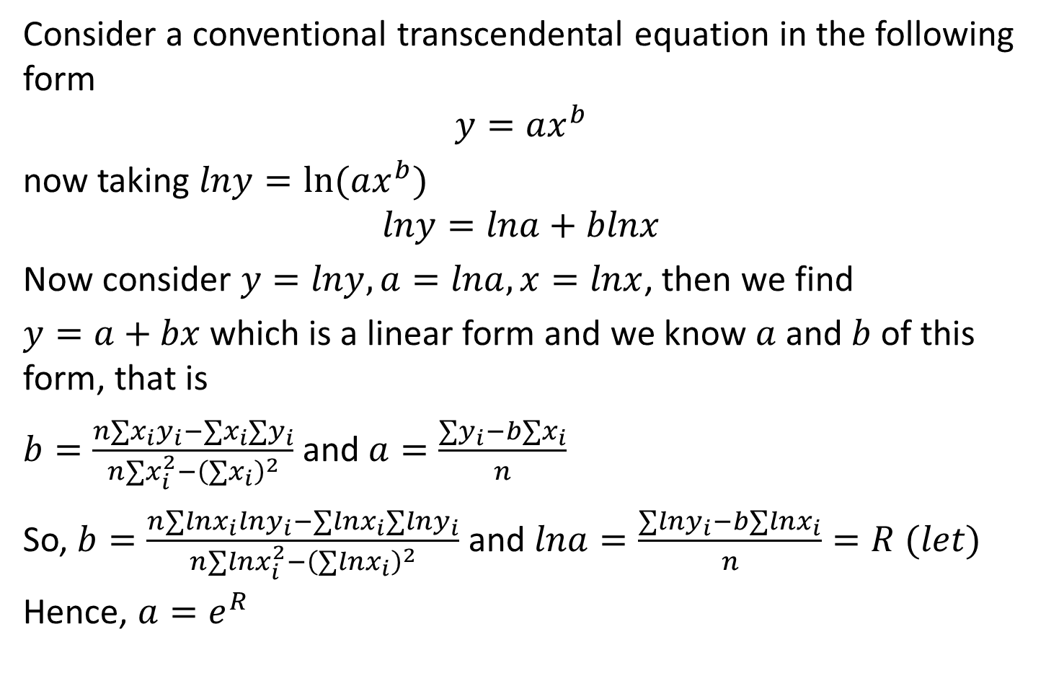
Least Square Regression: Transcendental Equation
Consider a conventional transcendental equation in the following form
$$y=ax^{b}$$
now taking $lny=ln⁡(ax^{b})$
$$lny=lna+blnx$$
Now consider $y=lny, a=lna, x=lnx$, then we find
$y=a+bx$ which is a linear form and we know $a$ and $b$ of this form, that is
$b=\frac{n∑x_{i}y_{i}−∑x_{i}∑y_{i}}{n∑x_{i}^{2}−{\left(∑x_{i}\right)}^{2}}$ and $a=\frac{∑y_{i}−b∑x_{i}}{n}$
So, $b=\frac{n∑lnx_{i}lny_{i}−∑lnx_{i}∑lny_{i}}{n∑lnx_{i}^{2}−{\left(∑lnx_{i}\right)}^{2}}$ and $lna=\frac{∑lny_{i}−b∑lnx_{i}}{n}=R (let)$
Hence, $a=e^{R}$

Slide 10
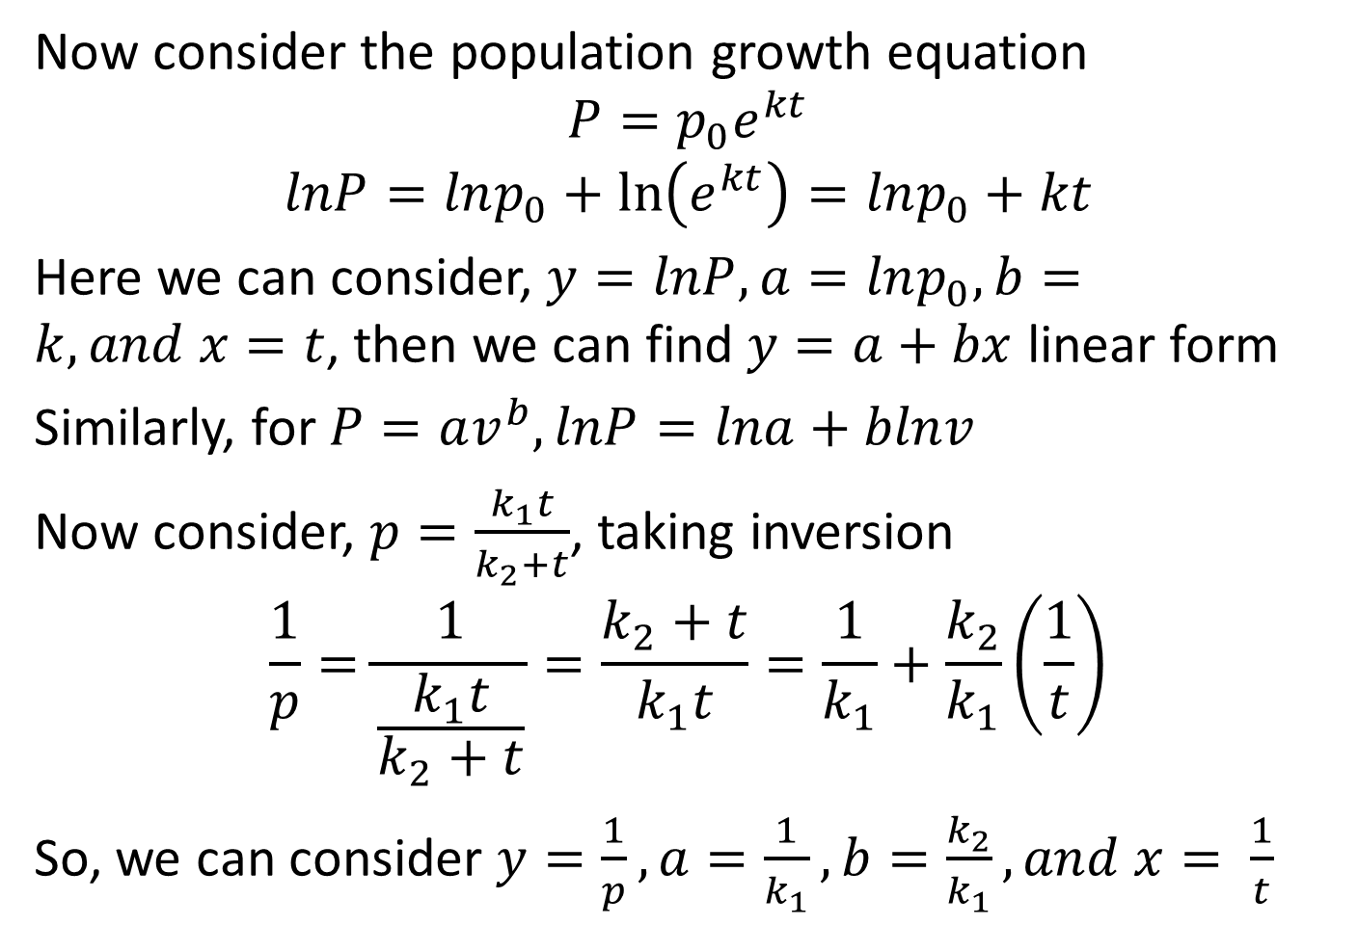
Least Square Regression: Transcendental Equation
Now consider the population growth equation
$$P=p_{0}e^{kt}$$
$$lnP=lnp_{0}+\ln\left(e^{kt}\right)=lnp_{0}+kt$$
Here we can consider, $y=lnP, a=lnp_{0},b=k, and x=t$, then we can find $y=a+bx$ linear form
Similarly, for $P=av^{b}, lnP=lna+blnv$
Now consider, $p=\frac{k_{1}t}{k_{2}+t}$, taking inversion
$$\frac{1}{p}=\frac{1}{\frac{k_{1}t}{k_{2}+t}}=\frac{k_{2}+t}{k_{1}t}=\frac{1}{k_{1}}+\frac{k_{2}}{k_{1}}\left(\frac{1}{t}\right)$$
So, we can consider $y=\frac{1}{p},a=\frac{1}{k_{1}}, b=\frac{k_{2}}{k_{1}}, and x= \frac{1}{t}$

Slide 11

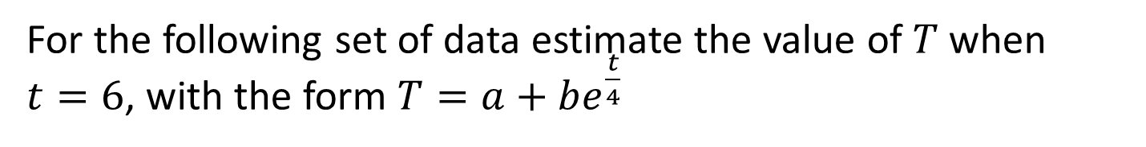
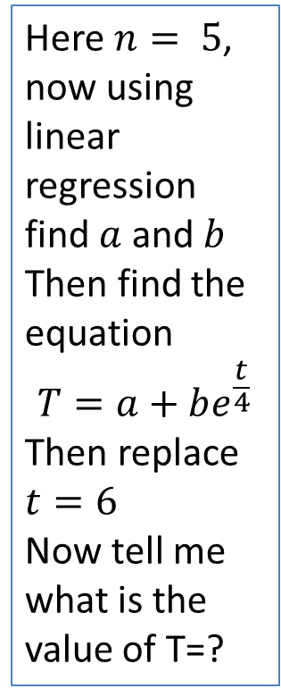
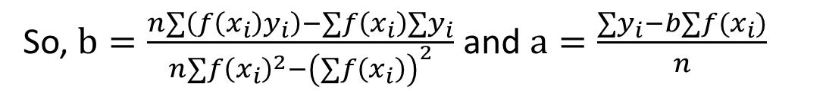
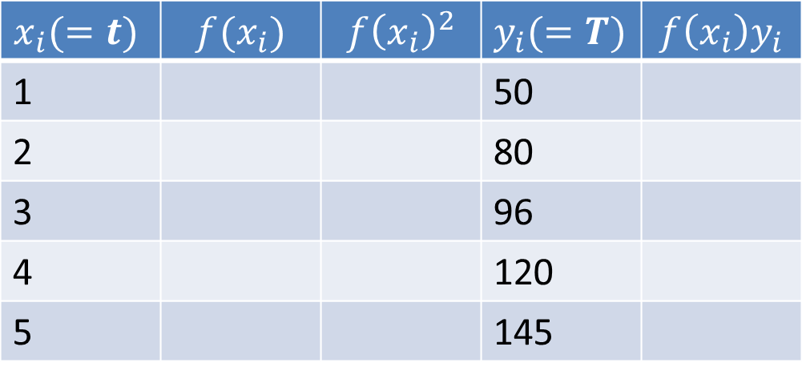

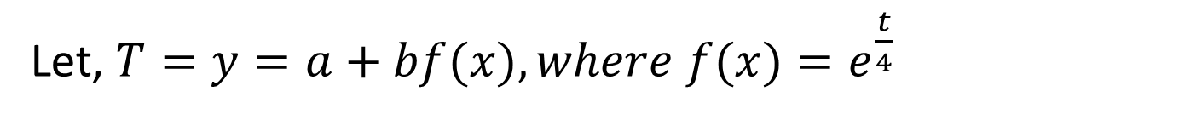

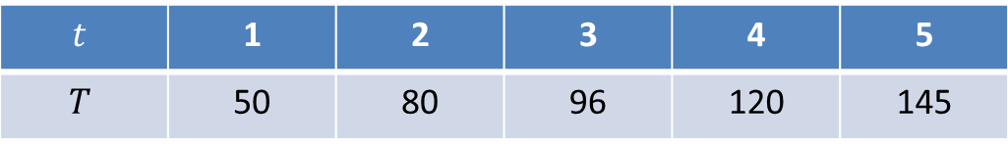

Least Square Regression: Transcendental Equation
For the following set of data estimate the value of $T$ when $t=6$, with the form $T=a+be^{\frac{t}{4}}$
$$t$$ | 1 | 2 | 3 | 4 | 5
$$T$$ | 50 | 80 | 96 | 120 | 145
Let, $T=y=a+bf(x), where f(x)=e^{\frac{t}{4}}$
Here $n= 5$, now using linear regression find $a$and $b$
Then find the equation
$$T=a+be^{\frac{t}{4}}$$
Then replace $t=6$
Now tell me what is the value of T=?
So, $b=\frac{n∑\left(f\left(x_{i}\right)y_{i}\right)−∑f\left(x_{i}\right){∑y}_{i}}{n∑f{\left(x_{i}\right)}^{2}−{\left(∑f\left(x_{i}\right)\right)}^{2}}$ and $a=\frac{∑y_{i}−b∑f(x_{i})}{n}$
$$x_{i}(=t)$$ | $$f(x_{i})$$ | $$f{\left(x_{i}\right)}^{2}$$ | $y_{i}(=T)$ | $$f\left(x_{i}\right)y_{i}$$
1 |  |  | 50
2 |  |  | 80
3 |  |  | 96
4 |  |  | 120
5 |  |  | 145
1.28
1.64
64
1.65
3.49
$$∑f\left(x_{i}\right)=?$$
$$∑f{\left(x_{i}\right)}^{2}=?$$
$$∑y_{i}=?$$
$$∑f\left(x_{i}\right)y_{i}=?$$

Slide 12
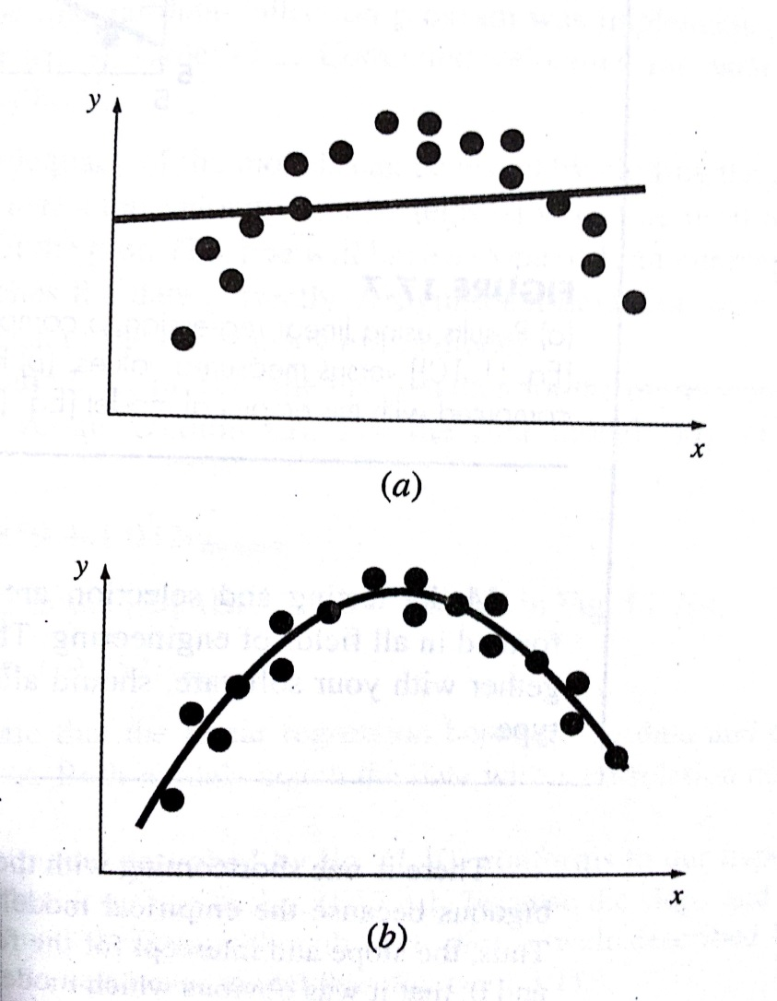
Least Square Regression: Polynomial Equation
Linear regression is not always suitable for representing data, polynomial regression can be used in such case to fit the data

Slide 13

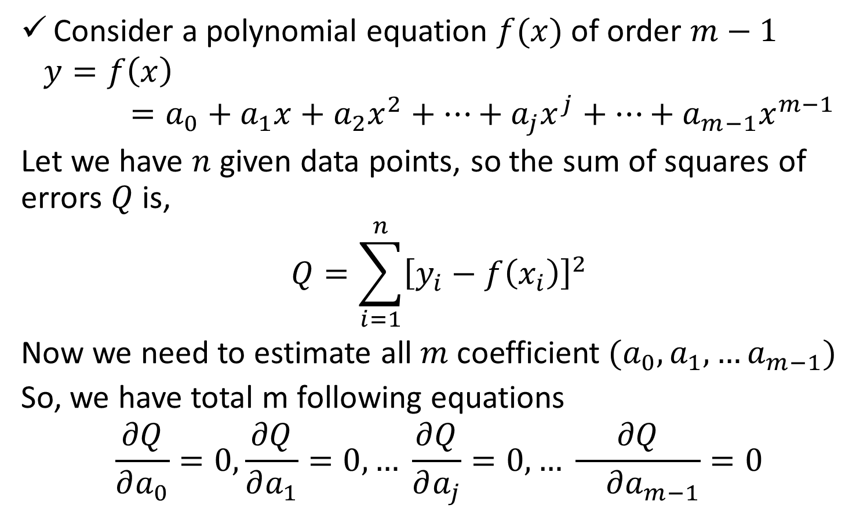
Least Square Regression: Polynomial Equation
Consider a polynomial equation $f(x)$ of order $m−1$
$$y=f\left(x\right)=a_{0}+a_{1}x+a_{2}x^{2}+…+a_{j}x^{j}+…+a_{m−1}x^{m−1}$$
Let we have $n$ given data points, so the sum of squares of errors $Q$ is,
$$Q=\sum_{i=1}^{n}{{\left[y_{i}−f\left(x_{i}\right)\right]}^{2}}$$
Now we need to estimate all $m$ coefficient $(a_{0},a_{1},…a_{m−1})$
So, we have total m following equations
$$\frac{∂Q}{∂a_{0}}=0,\frac{∂Q}{∂a_{1}}=0,… \frac{∂Q}{∂a_{j}}=0,… \frac{∂Q}{ ∂a_{m−1}}=0$$

Slide 14
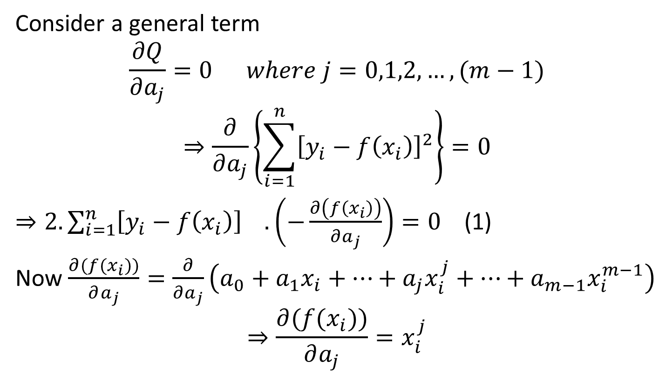
Least Square Regression: Polynomial Equation
Consider a general term
$$\frac{∂Q}{∂a_{j}}=0 where j=0,1,2,…,(m−1)$$
$$⇒\frac{∂}{∂a_{j}}\left\{\sum_{i=1}^{n}{{\left[y_{i}−f\left(x_{i}\right)\right]}^{2}}\right\}=0$$
$⇒2.\sum_{i=1}^{n}{{\left[y_{i}−f\left(x_{i}\right)\right]}^{}}.\left(−\frac{∂\left(f\left(x_{i}\right)\right)}{∂a_{j}}\right)=0$ (1)
Now $\frac{∂(f(x_{i}))}{∂a_{j}}=\frac{∂}{∂a_{j}}\left(a_{0}+a_{1}x_{i}+…+a_{j}x_{i}^{j}+…+a_{m−1}x_{i}^{m−1}\right)$
$$⇒\frac{∂(f(x_{i}))}{∂a_{j}}=x_{i}^{j}$$

Slide 15
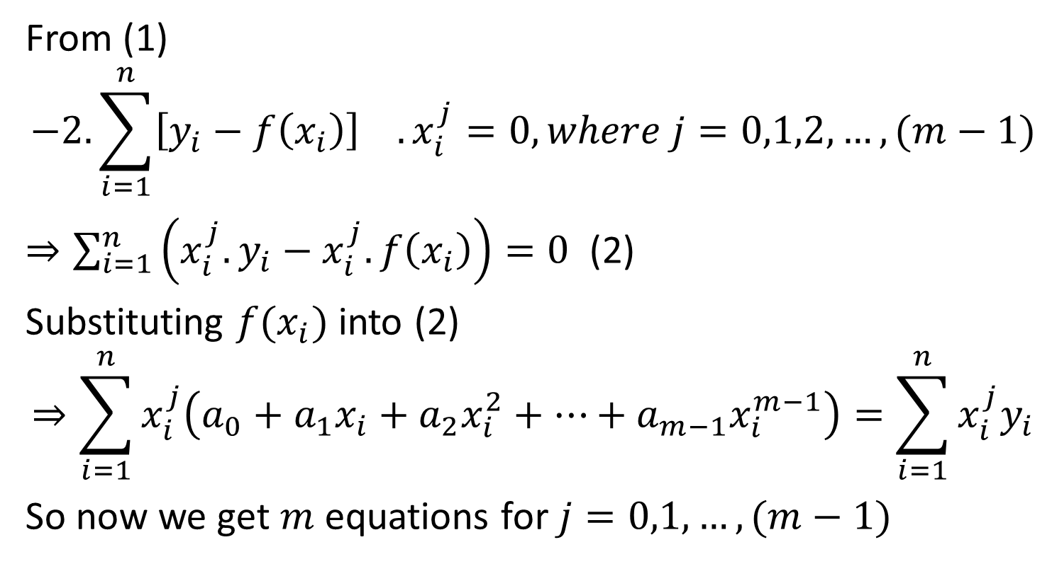
Least Square Regression: Polynomial Equation
From (1)
$$−2.\sum_{i=1}^{n}{{\left[y_{i}−f\left(x_{i}\right)\right]}^{}}.x_{i}^{j}=0, where j=0,1,2,…,(m−1)$$
$⇒\sum_{i=1}^{n}{\left(x_{i}^{j}.y_{i}−x_{i}^{j}.f\left(x_{i}\right)\right)}=0$ (2)
Substituting $f(x_{i})$into (2)
$$⇒\sum_{i=1}^{n}{x_{i}^{j}\left(a_{0}+a_{1}x_{i}+a_{2}x_{i}^{2}+…+a_{m−1}x_{i}^{m−1}\right)}=\sum_{i=1}^{n}{x_{i}^{j}y_{i}}$$
So now we get $m$ equations for $j=0,1,…,(m−1)$

Slide 16
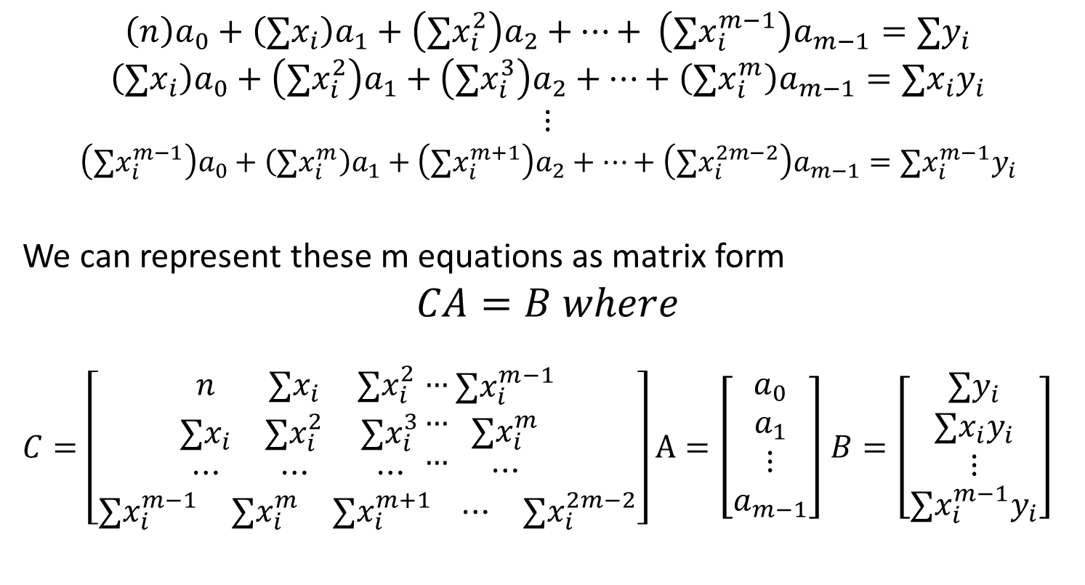
Least Square Regression: Polynomial Equation
$$\left(n\right)a_{0}+\left(∑x_{i}\right)a_{1}+\left(∑x_{i}^{2}\right)a_{2}+…+ \left(∑x_{i}^{m−1}\right)a_{m−1}=∑y_{i}$$
$$\left(∑x_{i}\right)a_{0}+\left(∑x_{i}^{2}\right)a_{1}+\left(∑x_{i}^{3}\right)a_{2}+…+\left(∑x_{i}^{m}\right)a_{m−1}=∑x_{i}y_{i}$$
$$⋮$$
$$\left(∑x_{i}^{m−1}\right)a_{0}+\left(∑x_{i}^{m}\right)a_{1}+\left(∑x_{i}^{m+1}\right)a_{2}+…+\left(∑x_{i}^{2m−2}\right)a_{m−1}=∑x_{i}^{m−1}y_{i}$$
We can represent these m equations as matrix form
$$CA=B where$$
$C=\left[\begin{aligned}\begin{matrix}n & ∑x_{i} & ∑x_{i}^{2} \\ ∑x_{i} & ∑x_{i}^{2} & ∑x_{i}^{3} \\ ⋯ & ⋯ & ⋯\end{matrix}\begin{matrix}… \\ … \\ …\end{matrix} \begin{matrix}∑x_{i}^{m−1} \\ ∑x_{i}^{m} \\ ⋯\end{matrix} \\ \begin{matrix}∑x_{i}^{m−1} & ∑x_{i}^{m} & ∑x_{i}^{m+1}\end{matrix} \begin{matrix}⋯ & ∑x_{i}^{2m−2}\end{matrix}\end{aligned}\right]$ $A=\left[\begin{matrix}a_{0} \\ a_{1} \\ \begin{aligned}⋮ \\ a_{m−1}\end{aligned}\end{matrix}\right]$ $B=\left[\begin{matrix}∑y_{i} \\ ∑x_{i}y_{i} \\ \begin{aligned}⋮ \\ ∑x_{i}^{m−1}y_{i}\end{aligned}\end{matrix}\right]$

Slide 17
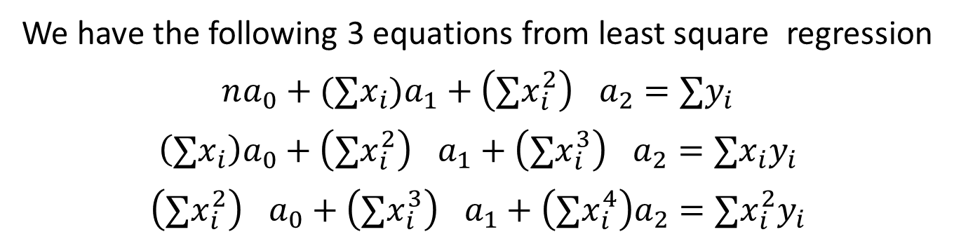
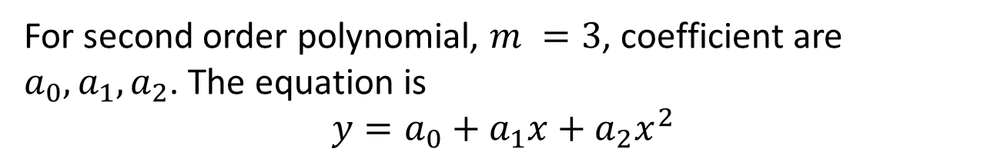
Least Square Regression: Polynomial Equation
Fit a second order polynomial to the data in the following table
x | 1 | 2 | 3 | 4 | 5
y | 6 | 11 | 18 | 27 | 38
For second order polynomial, $m =3$, coefficient are $a_{0}, a_{1}, a_{2}$. The equation is
$$y=a_{0}+a_{1}x+a_{2}x^{2}$$
We have the following 3 equations from least square regression
$$na_{0}+(∑x_{i}{)a}_{1}+{\left(∑x_{i}^{2}\right)}^{}a_{2}=∑y_{i}$$
$$\left(∑x_{i}\right)a_{0}+{\left(∑x_{i}^{2}\right)}^{}a_{1}+{\left(∑x_{i}^{3}\right)}^{}a_{2}=∑x_{i}y_{i}$$
$${\left(∑x_{i}^{2}\right)}^{}a_{0}+{\left(∑x_{i}^{3}\right)}^{}a_{1}+\left(∑x_{i}^{4}\right)a_{2}=∑x_{i}^{2}y_{i}$$

Slide 18
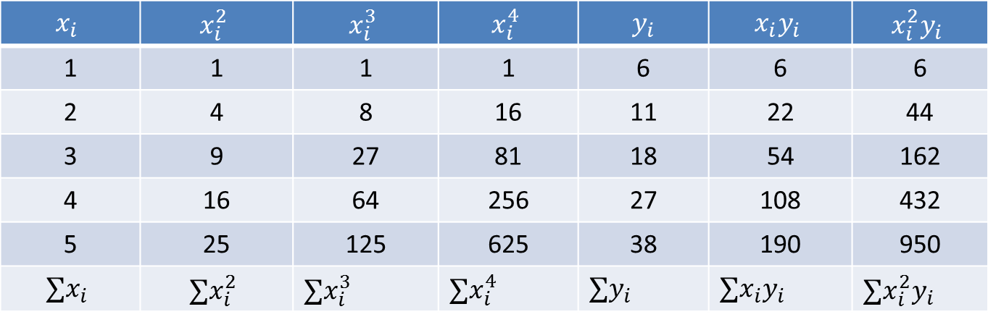
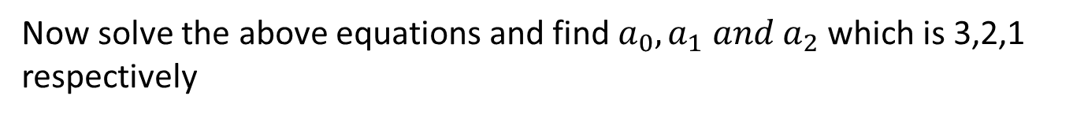
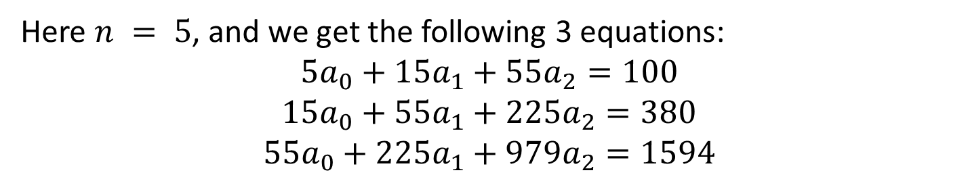
Least Square Regression: Polynomial Equation
So, now we calculate the required terms from the given table
$$x_{i}$$ | $$x_{i}^{2}$$ | $$x_{i}^{3}$$ | $$x_{i}^{4}$$ | $y_{i}$ | $$x_{i}y_{i}$$ | $$x_{i}^{2}y_{i}$$
1 | 1 | 1 | 1 | 6 | 6 | 6
2 | 4 | 8 | 16 | 11 | 22 | 44
3 | 9 | 27 | 81 | 18 | 54 | 162
4 | 16 | 64 | 256 | 27 | 108 | 432
5 | 25 | 125 | 625 | 38 | 190 | 950
$$∑x_{i}$$ | $$∑x_{i}^{2}$$ | $$∑x_{i}^{3}$$ | $∑x_{i}^{4}$ | $∑y_{i}$ | $$∑x_{i}y_{i}$$ | $$∑x_{i}^{2}y_{i}$$
=15
=55
=225
=979
=100
=380
=1594
Here $n = 5$, and we get the following 3 equations:
$$5a_{0}+15a_{1}+55a_{2}=100$$
$$15a_{0}+55a_{1}+225a_{2}=380$$
$$55a_{0}+225a_{1}+979a_{2}=1594$$
Now solve the above equations and find $a_{0}, a_{1} and a_{2}$ which is 3,2,1 respectively
And then our desired equation is $y= a_{0}+a_{1}x+a_{2}x^{2}$, $⇒y=3+2x+x^{2}$

Slide 19
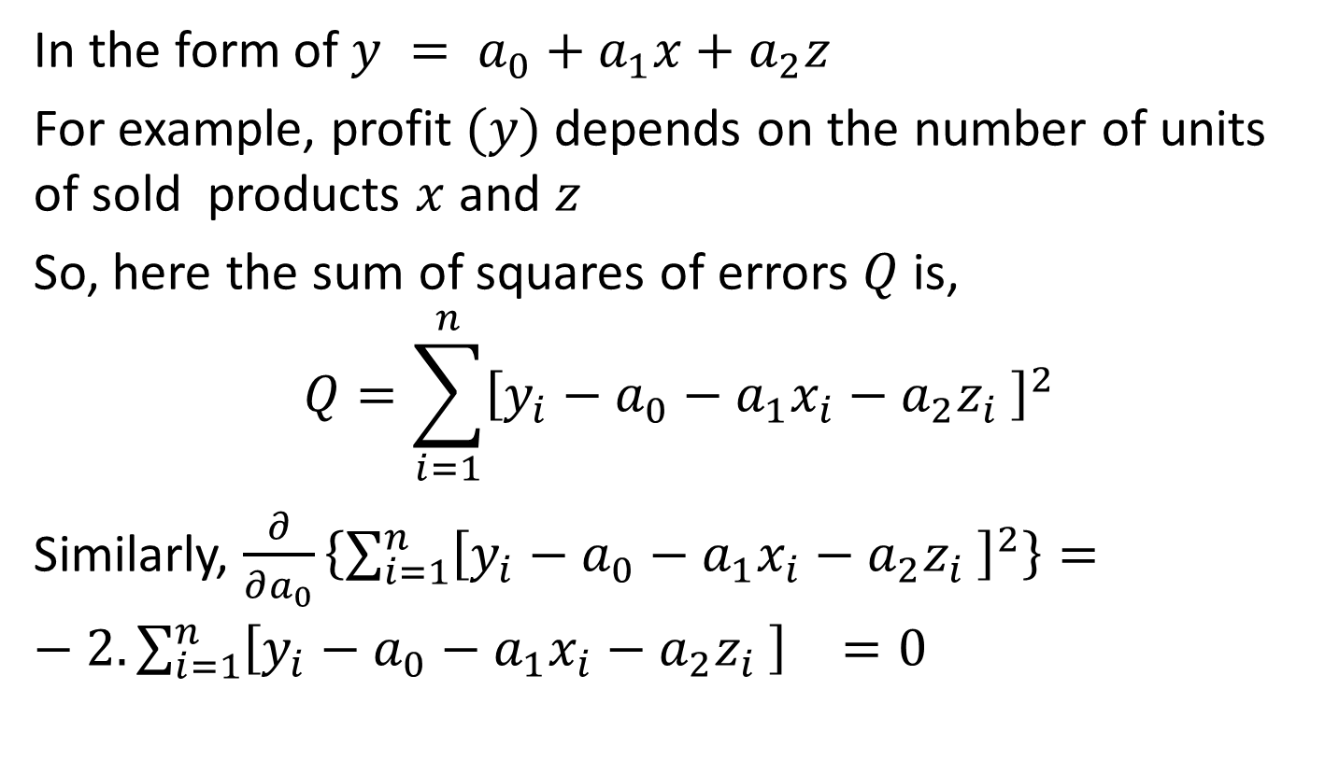
Least Square Regression: Multiple Linear Equation
In the form of $y = a_{0}+a_{1}x+a_{2}z$
For example, profit $(y)$depends on the number of units of sold products $x$ and $z$
So, here the sum of squares of errors $Q$ is,
$$Q=\sum_{i=1}^{n}{{\left[y_{i}−a_{0}−a_{1}x_{i}−a_{2}z_{i} \right]}^{2}}$$
Similarly, $\frac{∂}{∂a_{0}}\left\{\sum_{i=1}^{n}{{\left[y_{i}−a_{0}−a_{1}x_{i}−a_{2}z_{i} \right]}^{2}}\right\}=−2.\sum_{i=1}^{n}{{\left[y_{i}−a_{0}−a_{1}x_{i}−a_{2}z_{i} \right]}^{}=0}$

Slide 20
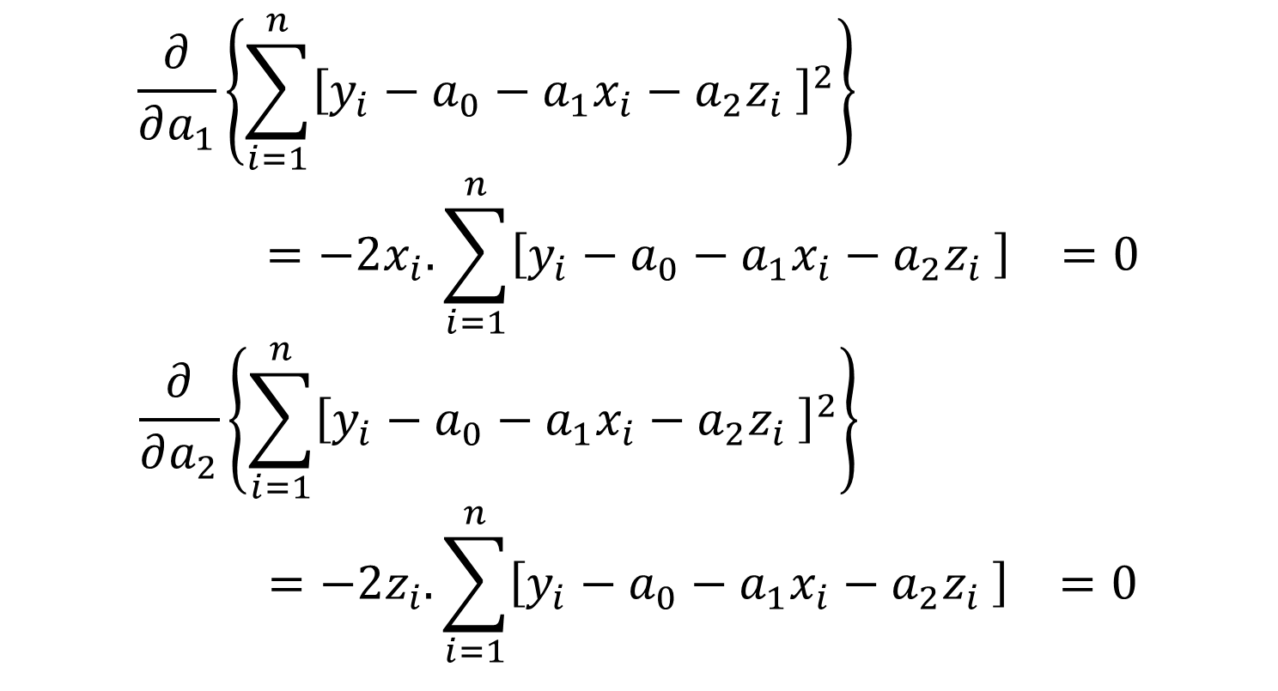
Least Square Regression: Multiple Linear Equation
$$\frac{∂}{∂a_{1}}\left\{\sum_{i=1}^{n}{{\left[y_{i}−a_{0}−a_{1}x_{i}−a_{2}z_{i} \right]}^{2}}\right\}=−2x_{i}.\sum_{i=1}^{n}{{\left[y_{i}−a_{0}−a_{1}x_{i}−a_{2}z_{i} \right]}^{}=0}$$
$$\frac{∂}{∂a_{2}}\left\{\sum_{i=1}^{n}{{\left[y_{i}−a_{0}−a_{1}x_{i}−a_{2}z_{i} \right]}^{2}}\right\}=−2z_{i}.\sum_{i=1}^{n}{{\left[y_{i}−a_{0}−a_{1}x_{i}−a_{2}z_{i} \right]}^{}=0}$$

Slide 21
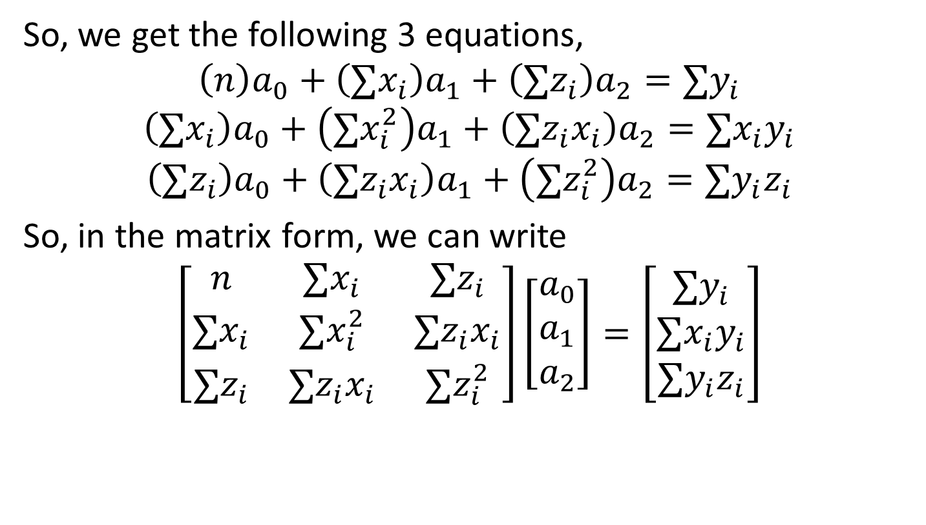
Least Square Regression: Multiple Linear Equation
So, we get the following 3 equations,
$$\left(n\right)a_{0}+\left(∑x_{i}\right)a_{1}+\left(∑z_{i}\right)a_{2}=∑y_{i}$$
$$\left(∑x_{i}\right)a_{0}+\left(∑x_{i}^{2}\right)a_{1}+\left(∑z_{i}x_{i}\right)a_{2}=∑{x_{i}y}_{i}$$
$$\left(∑z_{i}\right)a_{0}+\left(∑{z_{i}x}_{i}\right)a_{1}+\left(∑z_{i}^{2}\right)a_{2}=∑y_{i}z_{i}$$
So, in the matrix form, we can write
$$\left[\begin{matrix}n & ∑x_{i} & ∑z_{i} \\ ∑x_{i} & ∑x_{i}^{2} & ∑z_{i}x_{i} \\ ∑z_{i} & ∑{z_{i}x}_{i} & ∑z_{i}^{2}\end{matrix}\right]\left[\begin{matrix}a_{0} \\ a_{1} \\ a_{2}\end{matrix}\right]=\left[\begin{matrix}∑y_{i} \\ ∑x_{i}y_{i} \\ ∑y_{i}z_{i}\end{matrix}\right]$$
As this regression is a two-dimensional case, we obtain a regression plane not a line

Slide 22
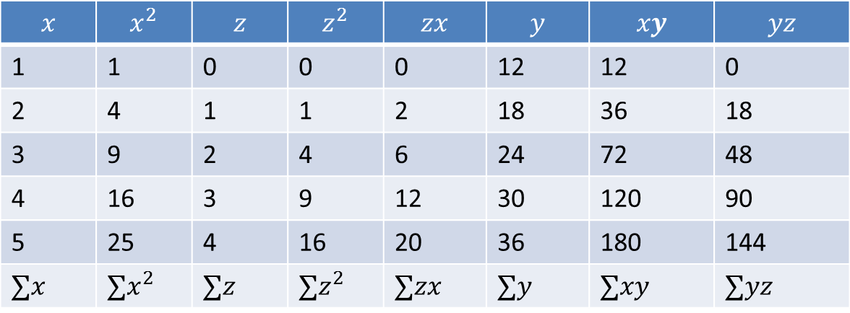
Least Square Regression: Multiple Linear Equation
For the following given data set, find a regression plane
x | 1 | 2 | 3 | 4 | 5
z | 0 | 1 | 2 | 3 | 4
y | 12 | 18 | 24 | 30 | 36
Our regression plane is, $y=a_{0}+a_{1}x+a_{2}z$
$$x$$ | $$x^{2}$$ | $$z$$ | $$z^{2}$$ | $$zx$$ | $$y$$ | $$xy$$ | $$yz$$
1 | 1 | 0 | 0 | 0 | 12 | 12 | 0
2 | 4 | 1 | 1 | 2 | 18 | 36 | 18
3 | 9 | 2 | 4 | 6 | 24 | 72 | 48
4 | 16 | 3 | 9 | 12 | 30 | 120 | 90
5 | 25 | 4 | 16 | 20 | 36 | 180 | 144
$$∑x$$ | $$∑x^{2}$$ | $$∑z$$ | $$∑z^{2}$$ | $$∑zx$$ | $$∑y$$ | $$∑xy$$ | $$∑yz$$
=15
=55
=10
=30
=40
=120
=420
=300

Slide 23
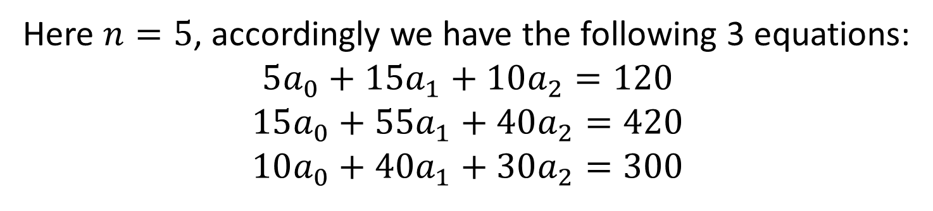
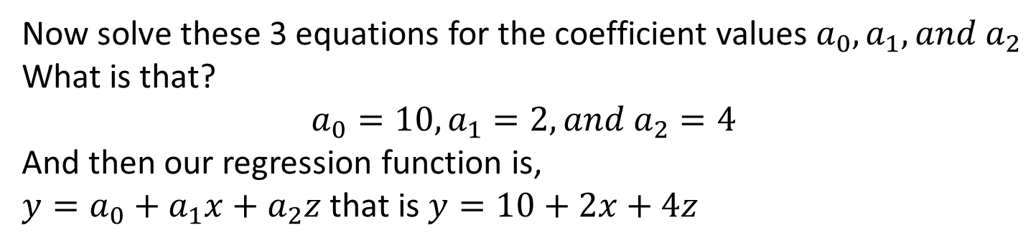
Least Square Regression: Multiple Linear Equation
Here $n=5$, accordingly we have the following 3 equations:
$$5a_{0}+15a_{1}+10a_{2}=120$$
$$15a_{0}+55a_{1}+40a_{2}=420$$
$$10a_{0}+40a_{1}+30a_{2}=300$$
Now solve these 3 equations for the coefficient values $a_{0}, a_{1}, and a_{2}$
What is that?
$$a_{0}=10, a_{1}=2, and a_{2}=4$$
And then our regression function is,
$y=a_{0}+a_{1}x+a_{2}z$ that is $y=10+2x+4z$

Slide 24
References
1. Numerical Methods by E Balagurusamy
2. Numerical Methods for Engineers by S.C. Chapra, R.P. Canale

